Slide 1
2nd Floor –Suite 220a 15550 Sand Canyon Ave Irvine, CA 92618 Test Fit March 2020
FINAL PROGRAMMING METRICS
10,177
N.I.C.
Approx. Rentable Square Feet
45
Number of Assigned Seats
N.I.C.
226
Suite 220a
Approx. RSF per Assigned Seat
CORE AND SHELL

Slide 2
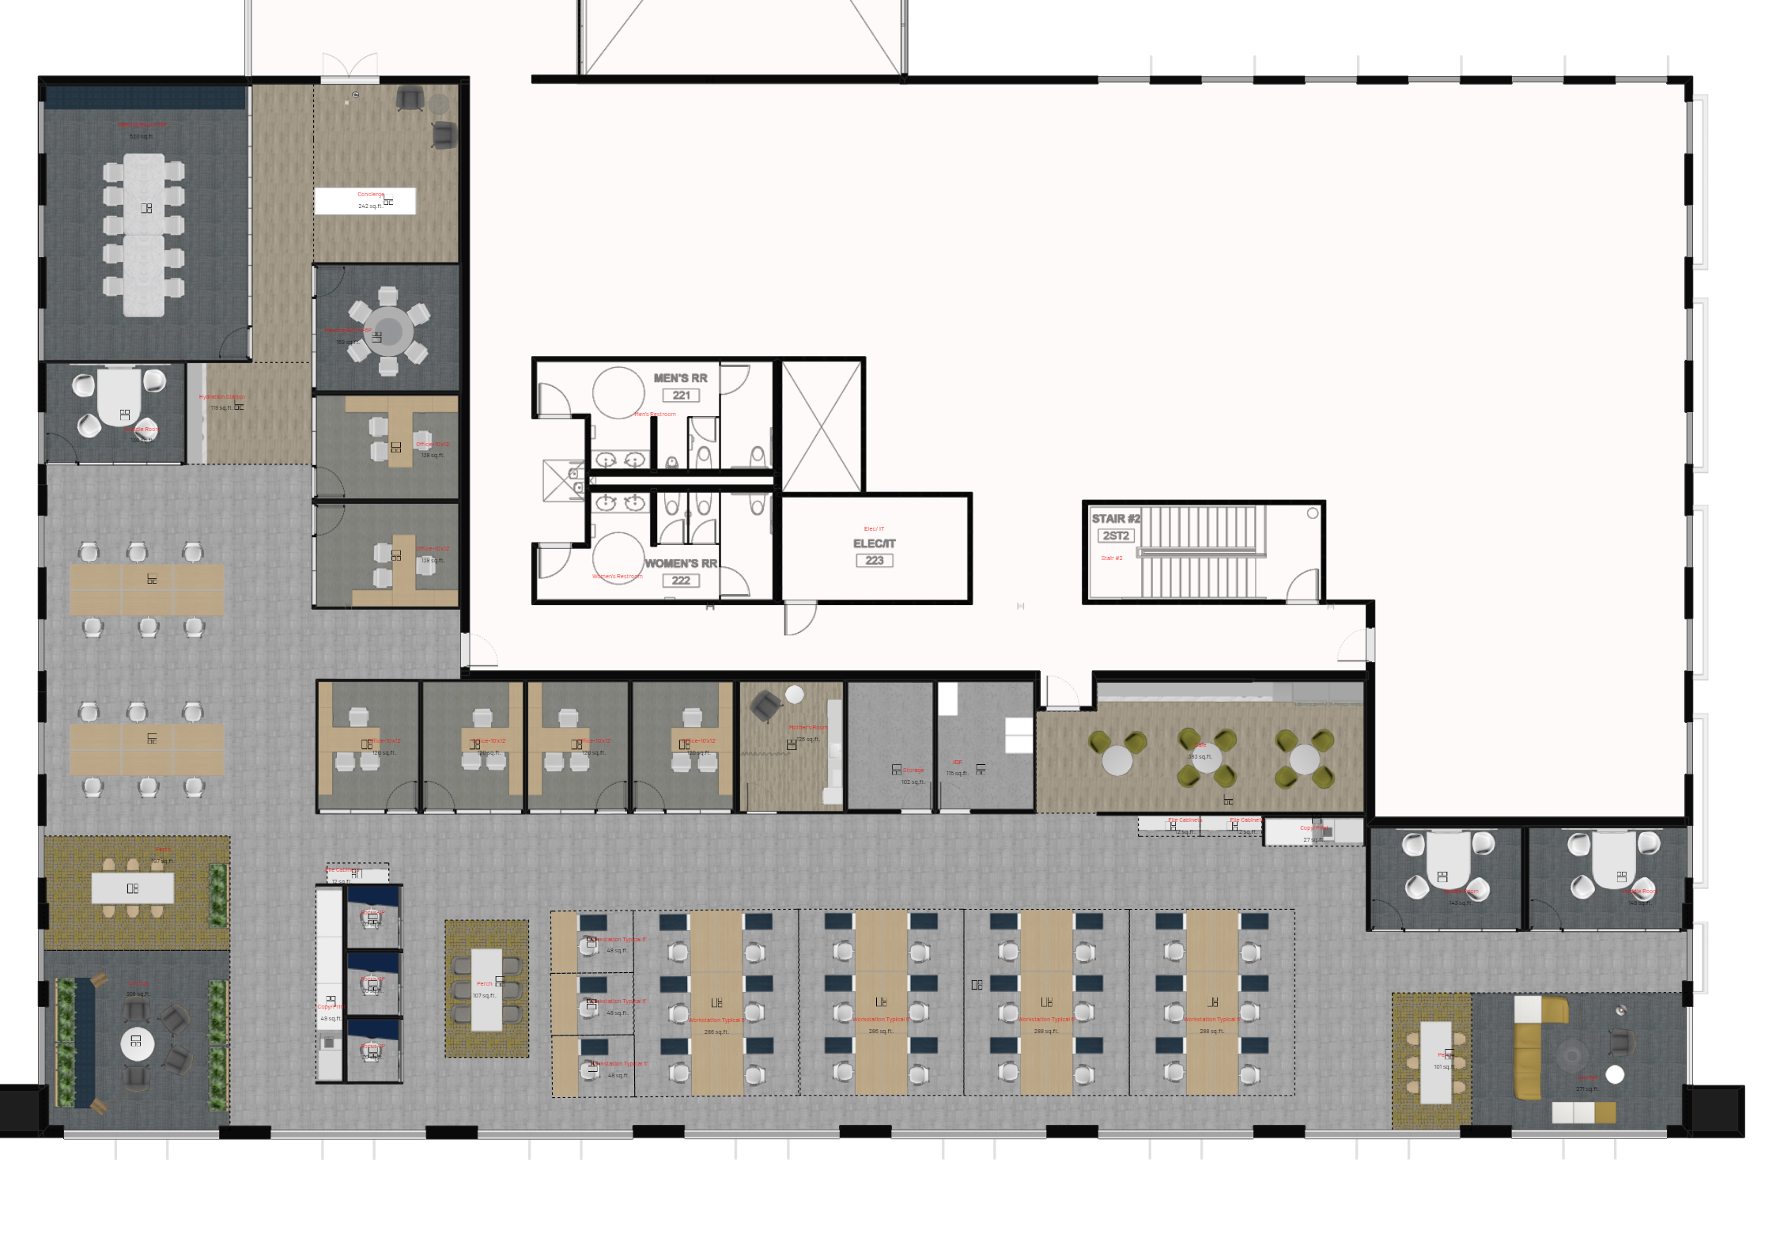
Floor Plan + Legend
Individual Spaces | Provided
Workstation-5’ Benches | 12
Workstation- 6’ L-Shaped | 27
Enclosed Office | 6
Collaborative Spaces | Provided
Focus Room- 1 person | 3
Huddle Room- 4 person | 3
Meeting Room-6 person | 1
Meeting Room-10 person | 1
Support + Wellbeing Spaces | Provided
Perch- 6 person | 3
Lounge | 2
Concierge/Greeting | 1
Hydration Station | 1
Cafe | 1
Copy-Print-Supply Point | 2
Mother’s Room | 1
IDF Room | 1
Storage Room | 1

Slide 3
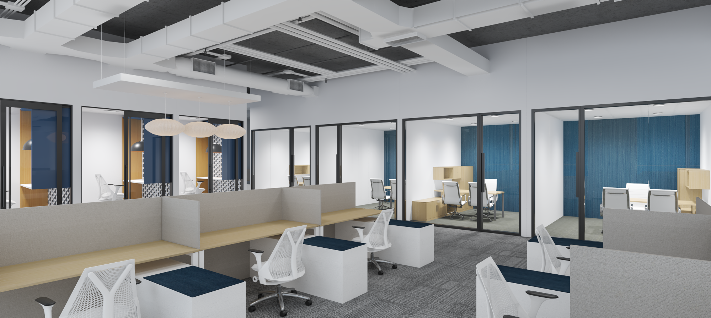
3D Walk Through + Renderings
Workstations, Private Offices, and Focus Rooms
Suite 220a
{click on link to access 3D walk through}

Slide 4
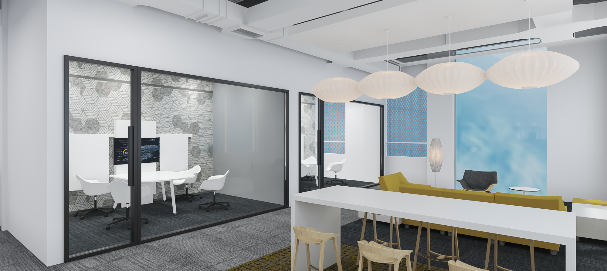
Huddle Room and Lounge

Slide 5
Axonometric

